Slide 1

CSCI410 – Mobile App
Taxora Project (Phase 1)
By: Jawad Jammoul & Khalil Kodeih
Represented to: Dr. Marwan Cheaito

Slide 2
Project Overview
Description: Taxora is a Flutter-based mobile application designed to simplify employee salary tax calculations. It allows users to enter an employee's name and monthly salary, automatically determines the applicable tax percentage based on predefined salary ranges, and calculates the final net salary after tax deduction.

Slide 3
Overview
Target Users:
Accountants
Payroll administrators
Human Resources (HR) employees
Individuals who want to estimate their net salary
Main Purpose: To provide a simple, fast, and efficient way to calculate employee salaries after tax deductions while reducing manual calculation errors.
Technology: Flutter & Dart.

Slide 4
Main Purpose
The main objective of Taxora is to simplify employee salary tax calculations by automating the deduction process and providing accurate net salary results.
Key Objectives:
Simplify Calculations: Automatically calculate salary deductions based on predefined tax percentages.
Reduce Errors: Minimize mistakes caused by manual calculations.
Save Time: Help accountants process employee salaries quickly and efficiently.
Ensure Accuracy: Provide accurate tax deduction and net salary results.
User-Friendly Experience: Offer a simple and organized interface that is easy to use.

Slide 5
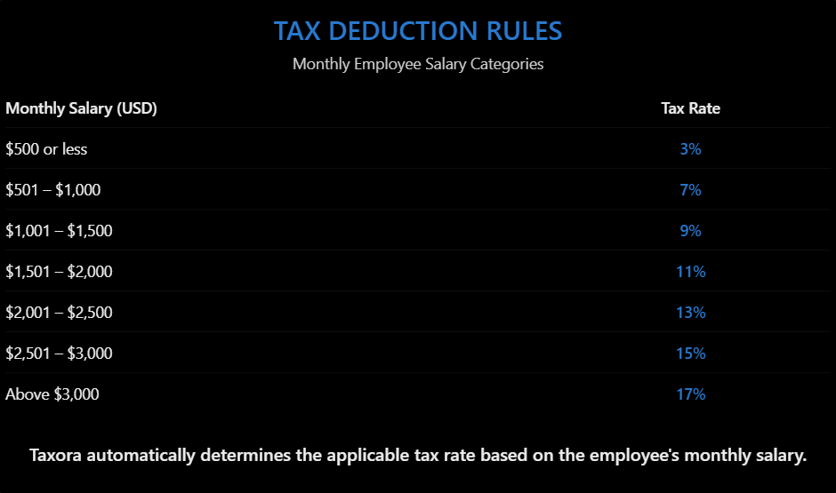
Tax Deduction Rules
Taxora classifies employee salaries into different categories, with a predefined tax deduction percentage assigned to each salary range. The application automatically identifies the applicable percentage based on the employee's monthly salary.
How It Works:
The application automatically selects the appropriate tax percentage according to the employee's salary and uses it to calculate the tax deduction and final net salary.

Slide 6
Application Functionality
Calculation Output:
Taxora provides a simple interface that allows accountants to enter employee information and calculate the employee's net salary after applying the appropriate tax deduction.
The application displays the employee's name, applicable tax percentage, tax deduction amount, and final net salary.
Employee Name Input: Allows the user to enter the employee's full name.
Monthly Salary Input: Allows the user to enter the employee's monthly salary in US dollars.
Enter Button: Calculates the applicable tax deduction and displays the final net salary.
Retry Button: Clears all previously entered information and removes the displayed result, allowing the user to perform another calculation.

Slide 7
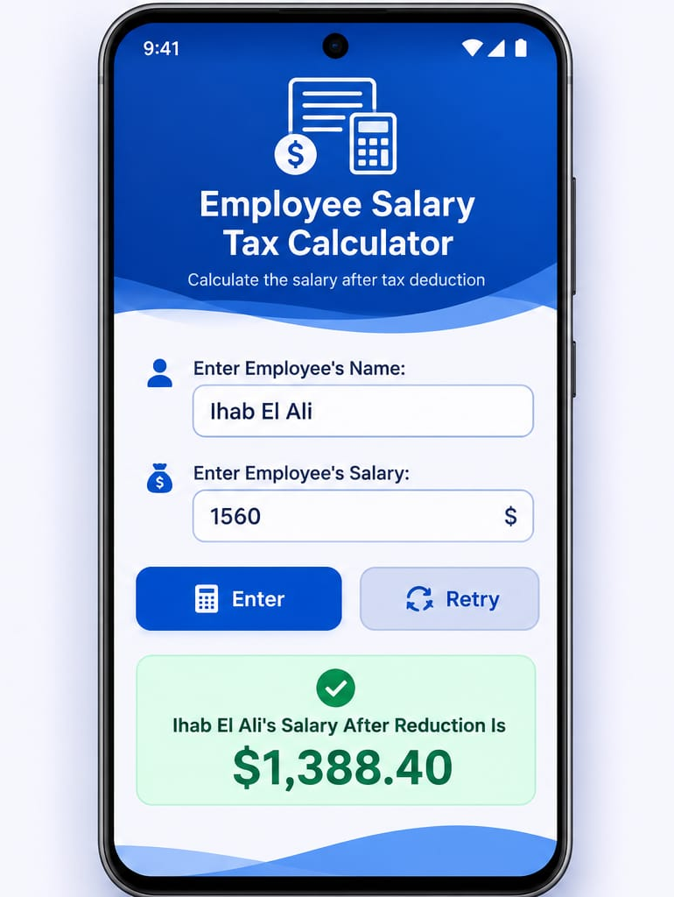
Application User Interface
Simple and User-Friendly Interface
The application provides a clear and organized interface that allows accountants to:
Enter the employee’s name and monthly salary.
Calculate the salary after tax deduction using the Enter button.
Clear the information and process another employee using the Retry button.
View the calculated net salary immediately on the screen.

Slide 8
Salary Tax Calculation
Employee Information
Employee Name: Ihab El Ali
Monthly Salary: $1,560
Applicable Tax Rate: 11%
Calculation
Tax Deduction = $1,560 × 11% = $171.60
Net Salary = $1,560 − $171.60 = $1,388.40
Output
“Ihab El Ali's Salary After Reduction Is $1,388.40”

Slide 9
Project Main Objectives
The main objectives of the application are:
Simplify employee salary tax calculations.
Reduce manual calculation errors.
Save accountants time and effort.
Provide accurate net salary results.
Offer a simple and user-friendly experience.

Slide 10

Technology Used
Taxora Project will be developed using Flutter, providing the technology used to build the application's mobile user interface and functionality.
You can access the project on Github once it’s done using the following link:
Taxora

Slide 11
Thanks for watching
Taxora – Phase 1
CSCI 410
Jawad Jammoul & Khalil Kodeih
Team Collaboration Note:
This project will be jointly developed by Jawad and Khalil. Both team members will actively contribute their time, effort, and technical skills throughout the development process. We will collaborate through regular in-person and online meetings, sharing responsibilities, discussing ideas, and working together to ensure the successful completion of the project. Neither member will be working independently; this is a joint effort built on equal participation and collaboration.

